Slide 1
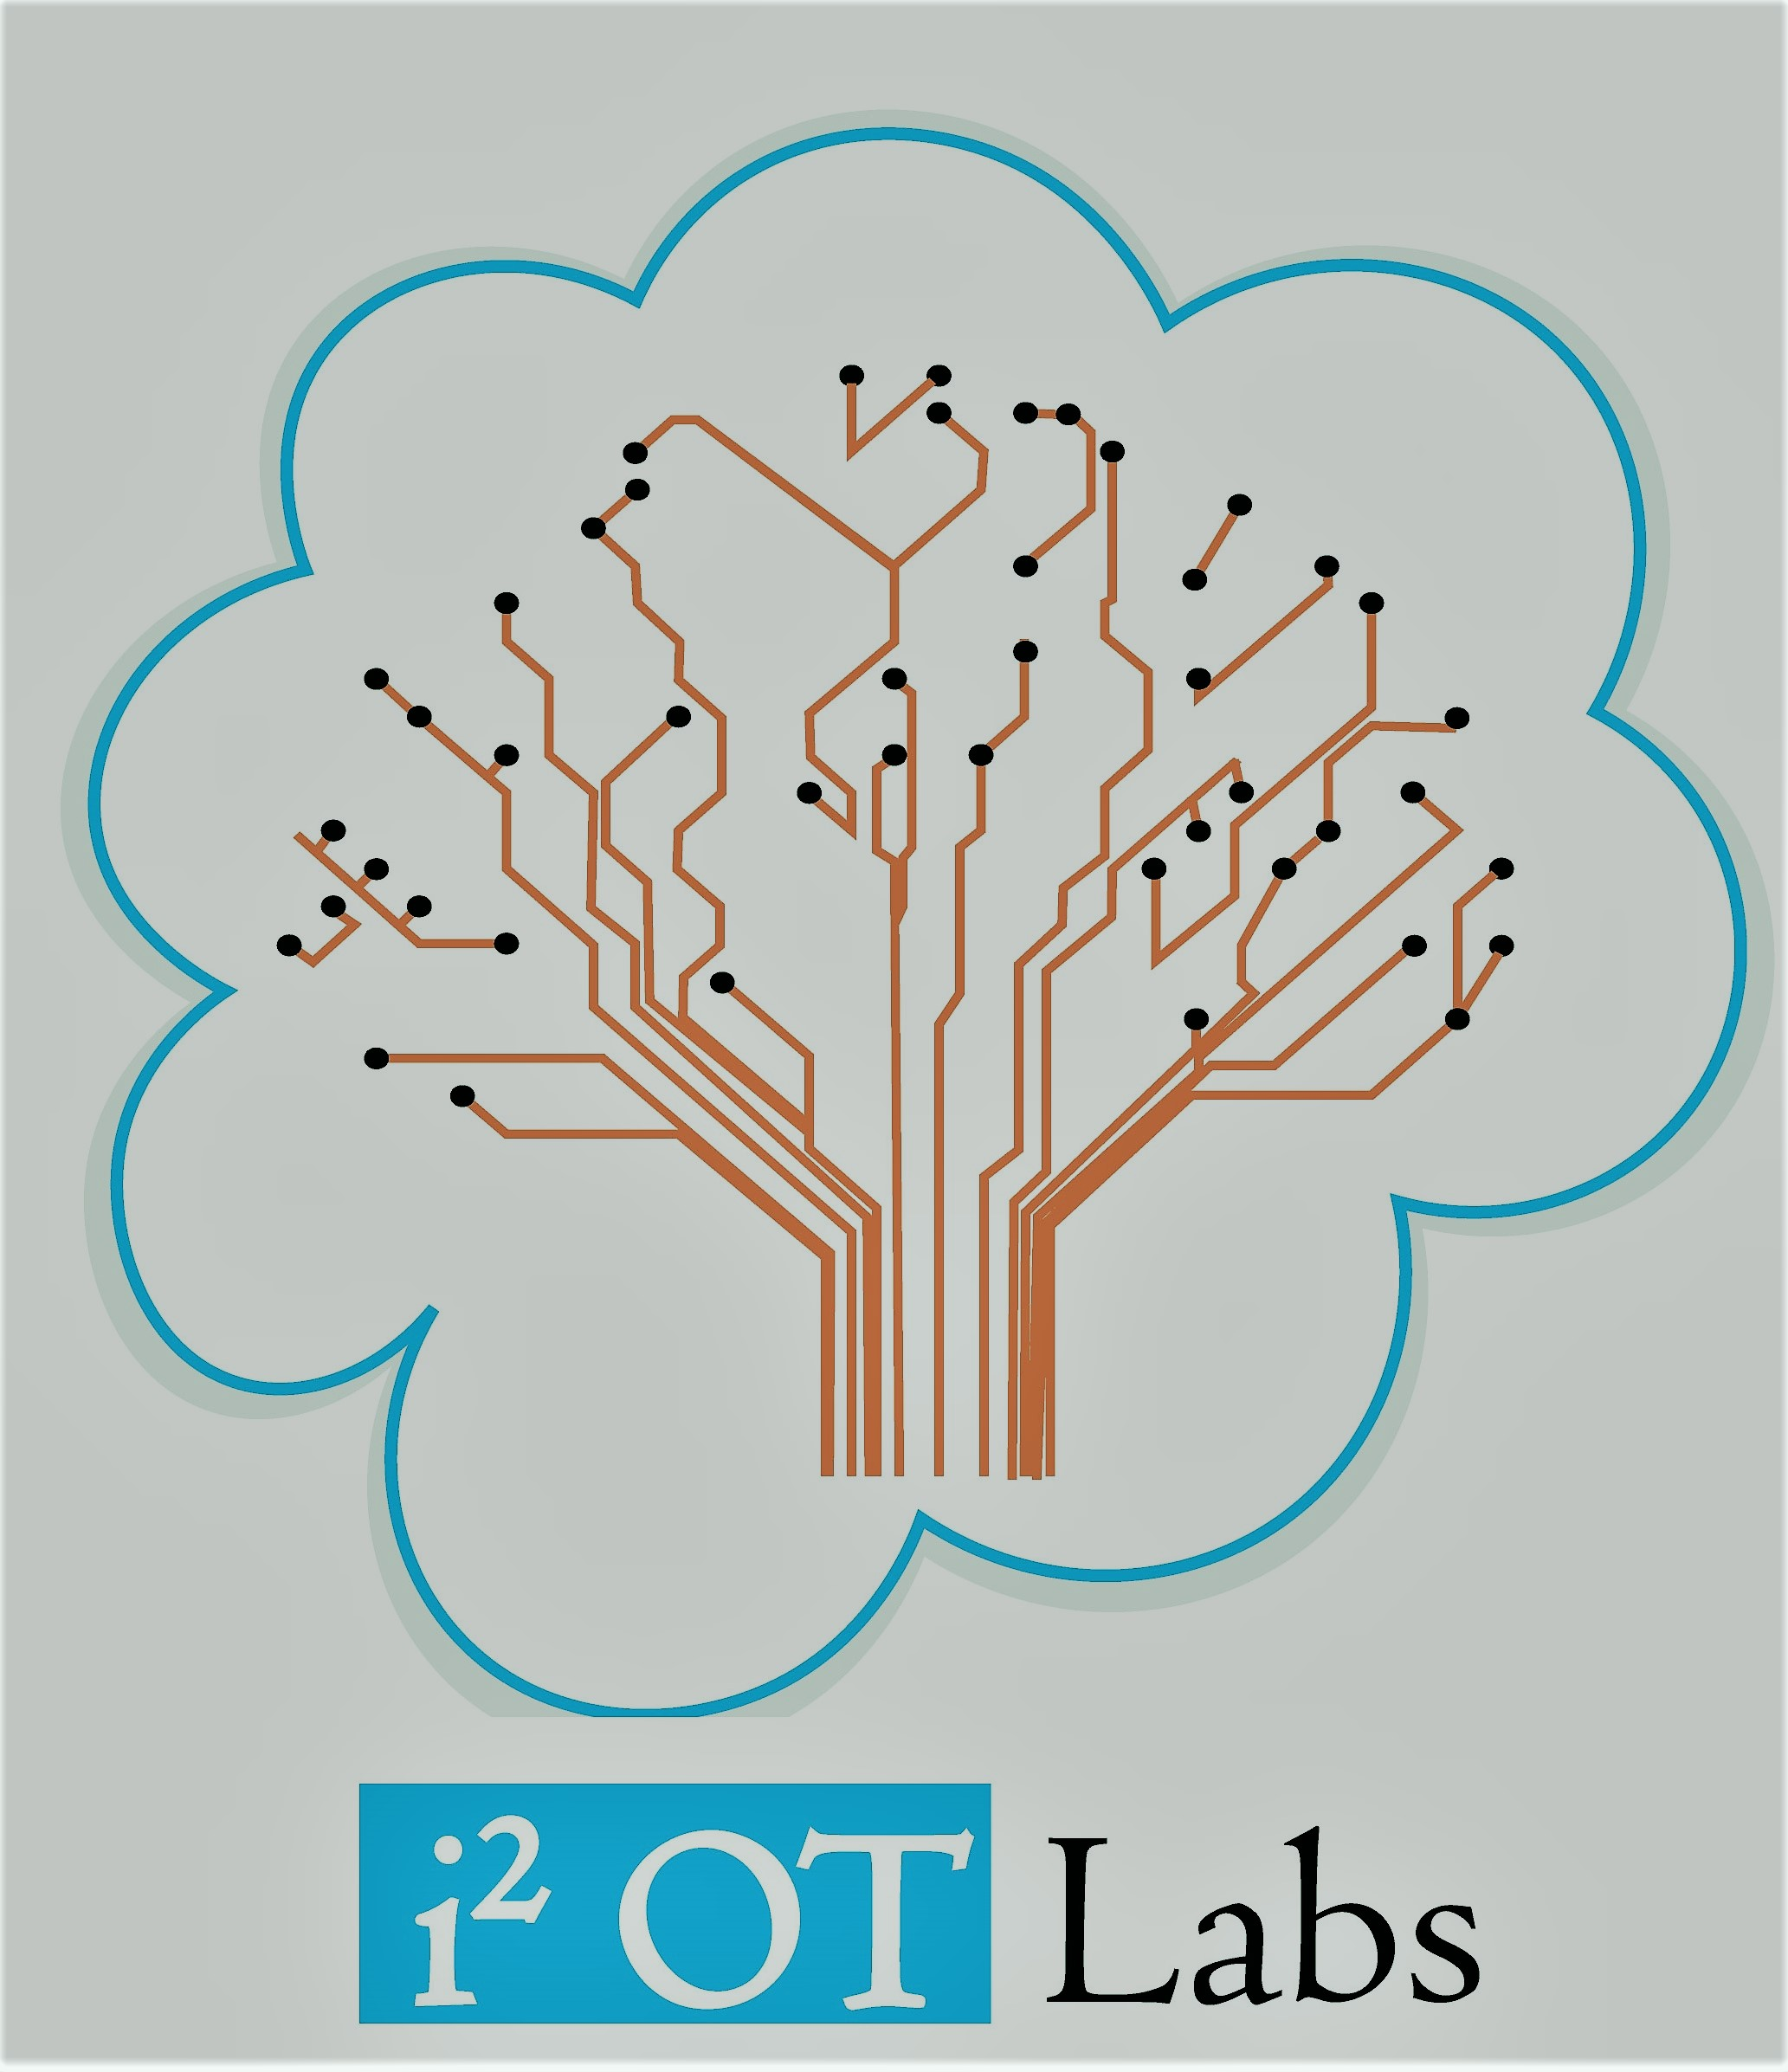
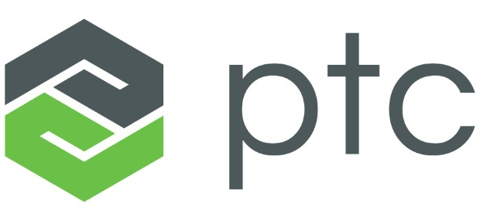
Introduction to IoT Thingworx
Partner
Girish S Kumar
I-Squared OT Labs (OPC) Pvt Ltd

Slide 2
I-Squared OT LABS
Technology Start-up Focused on providing End to End IoT solution
Manufacturing
Health Care
Transportation
Data centres
Emerging areas
Large scale Software deployments

Slide 3
What is Internet of Things
Internet of Things is a new concept in the field of engineering to connect Large number electronic devices to the Internet

Slide 4
What is the objective ?
Monitoring of equipment's at a large scale
Data Acquisition
Analytics
Command and Control
Inter device communication

Slide 5
Internet of Things
Internet of Things is not just limited to Electronic Devices or Electrical machines.
Plants/Trees/Agriculture
Soil and Water
Building
Infrastructure (Roads, Bridges)
Railway tracks
Sports

Slide 6
Scope is Endless
It needs, few sensors and an electronic board to communicate with Internet

Slide 7
What is a Thing ?
Internet of Things
A DEVICE OF INTEREST CONNECTED TO INTERNET

Slide 8
How does IoT brings Value ?
Monitor
Monitoring of large set of equipment/devices/machines through internet (mobile phone/Laptop)
Control
Online Control of the equipment’s / devices/machine through a mobile phone or laptop or a console
Optimize
Understand / learn the data collected from “Things” with the help of the state of the art Machine learning and Analytic methods and make changes or correction actions to improve productivity. Add value to Diagnostics through Machine Learning methods

Slide 9
How is it traditionally done
SCADA
Supervisory Control and Data Acquisition System,
PLC
Programmable Logic Controller
Read Inputs
Execute program
Diagnostics
Communication
Output
PLC /SCADA
Cycle

Slide 10
Where Does IoT Comes into picture
IoT is complementary to PLC/SCADA.
Data Collected PLC/SCADA systems forms one of the data sources for IoT.
Primary focus of PLC/SCADA is monitoring and control.
IoT’s main focus is to analyze the data which we had collected from machine (which we call as things) to
Bring in more operational effectiveness
Finding the key parameters that can impact the productivity
Find the Root Cause of failures and bottle necks
Early Detection Anomaly and taking proactive actions
Performing Diagnostic , Prescriptive and Predictive Analysis on machines
Process Improvement

Slide 11
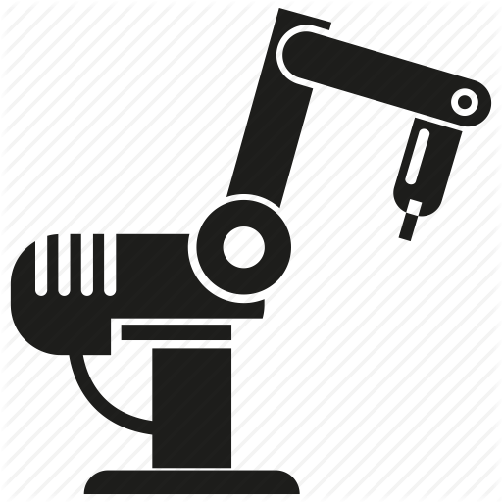
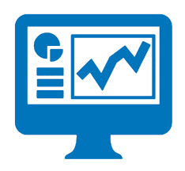
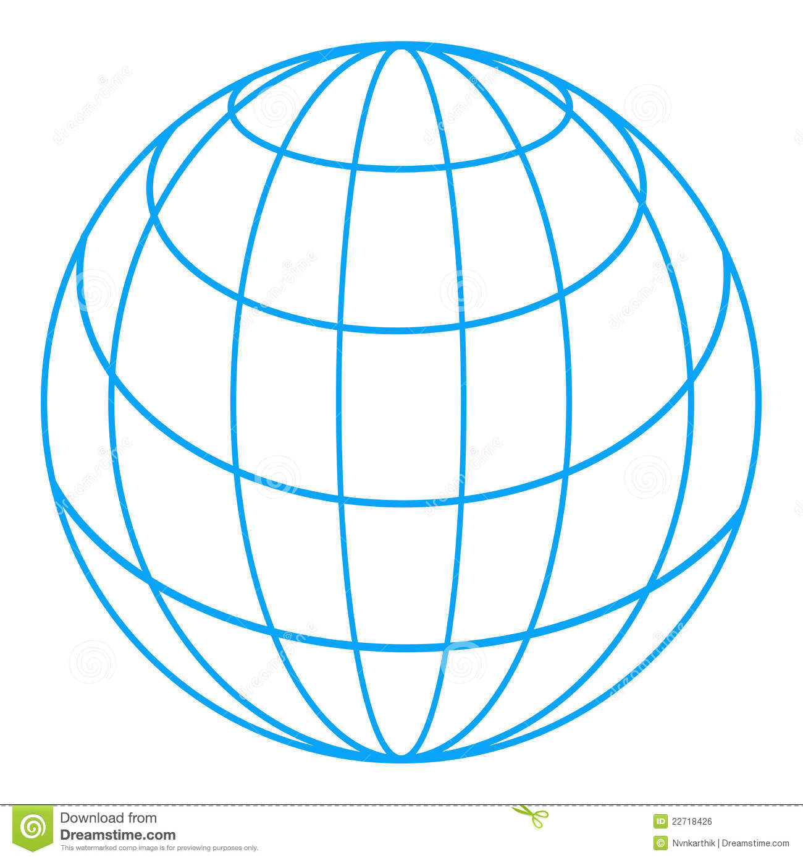
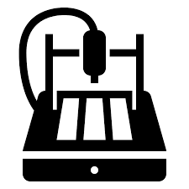
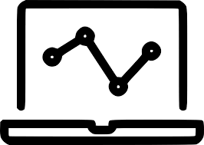
Transition to Smart Connected Factory (Industrie 4.0)
IoT
SCADA

Slide 12
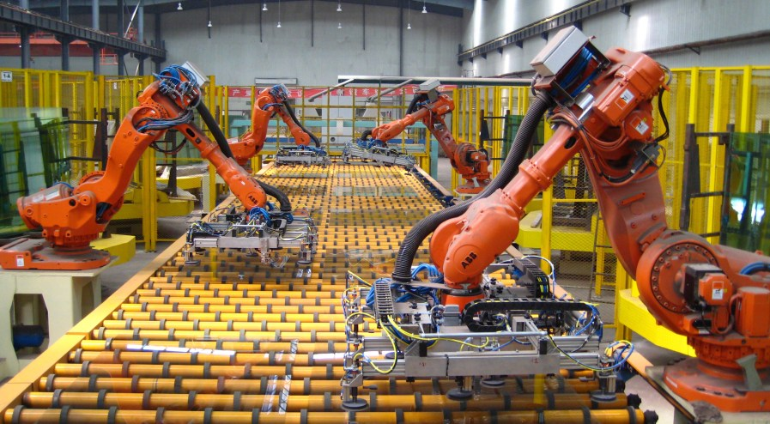
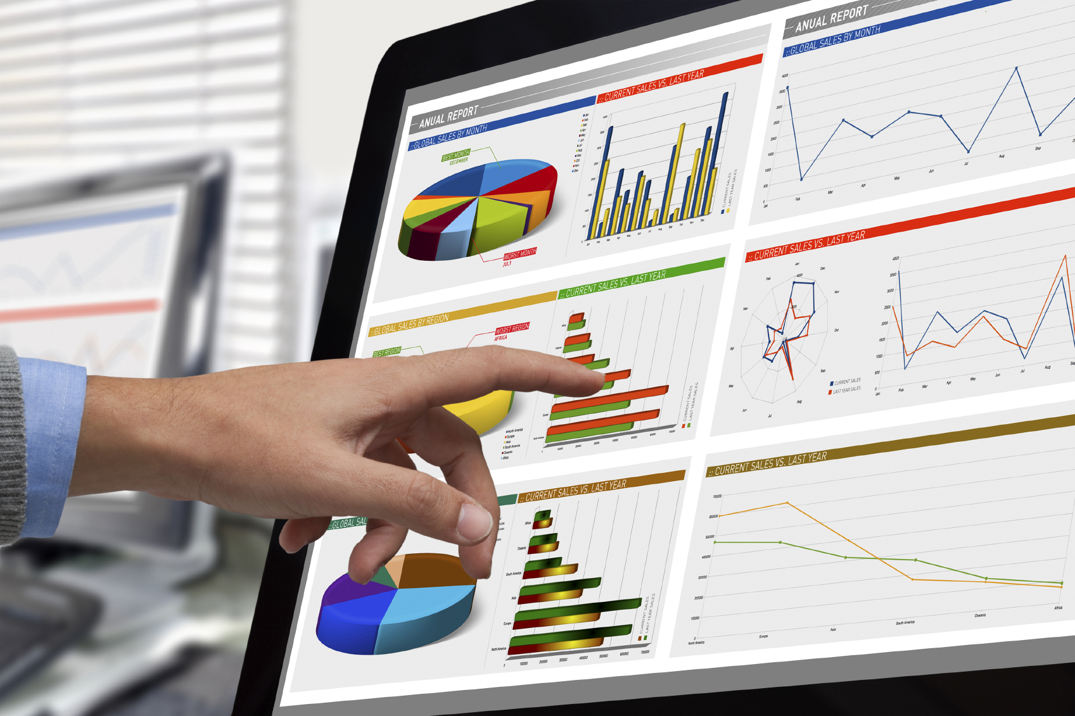
Deployment
Analytics
SCADA
IoT Platform
(Thingworx)
Integration with WEB /Smart phones/ console
Historical Data
Integration with ERP System
SCADA/Compliant Hardware
System Audit

Slide 13
Thingworx IoT Platform from

Slide 14
PTC ThingWorx is an application development platform for the Internet of Things
ThingWorx Foundation - Connects to other components of thingworx. Consists of model-based rapid application development tools (needs very little programming knowledge) , includes a drag-and-drop mashup builder for building dashboards and other web based applications
ThingWorx Utilities - helps users to define, manage, monitor and optimize their connected products
ThingWorx Analytics - Consists of predictive analytics of the data collected from devices. The module can also detect anomalies and patterns in real-time data. An analytics server adds the ability to monitor devices for predicted outcomes (such as equipment failure) and optimize them by automatically detecting the reasons for certain outcomes.
Kepware KepServerEX - an IoT gateway and other network software for integrating industrial systems, including SCADA (supervisory control and data acquisition) and MES (manufacturing execution system)software.
Thingworx Studio : Integrate IoT with Augmented Reality

Slide 15
Machine Learning

Slide 16
What is Machine Learning
Machine learning is an application of artificial intelligence that provides systems the ability to automatically learn from large amount of data and automatically program interpretation of the data.
Face Recognition
Hand writing recognition
Prediction of Weather/Stock Market
Diagnosis of health issues with patient data
Understanding the performance of machine based on data collected from sensor
Predicting failures of machine from data collected from Sensors
Are examples of Machine Learning. The last two bullets are the areas where Machine Learning is adding value to Industrial IoT.
Analytics Module which is packaged with Thingworx is Machine Learning Application that can be used for understanding data that is collected from sensors.

Slide 17
Where does Thingworx ML finds application
Industrial IoT/Manufacturing | Understanding data collected from machine and making predictions, detecting anomalies with performance
Insurance Companies | Classifying customers into broad categories based on customer data and generating risk profiles for each of them, This is used for fixing up premium
Hospital and Health Care | Analysing Data collected from patients for diagnosis of health issues, detecting anomalies with health.
Data Centres | To understand data collected from logs and making predictions, classification and anamolies with performance of routers, switches and servers etc
Transportation/Courier | To understand the data collected from vehicles and classify routes according to parameters. Make predictions about delivery and collection times

